Slide 1
Children's right to healthcare

Slide 2
KA2 – Cooperation for Innovation and the Erasmus+ Programme,
Exchange of Good Practices Strategic Partnership
KA219 – Strategic Partnerships for Schools Only Project No : 2107-1-FR
01-KA219-037504_5
Sharing the world : Project realized by:
right to healthcare Anamaria Aconstantinesei
Carina Ramona Lau
Stefan Bulboaca
Denisia Barbalata

Slide 3
PROJECT
Date: 17.04.2018
Class: 9 F
School Object: TIC
Subject: Knowing and respecting children's right to healthcare
Type of lesson: communication/ acquisition of new knowledge
Reserved Time: 50 minutes
Teacher:
Mihaiela Tunea
Elena-Magda Soptica

Slide 4
OBJECTIVES
O1 - to define the concepts of “right”, human rights( children`s rights)”;
O2 – to identify children`s rights and obligations, under the Convention on the Rights of the Child;
O3 – to compare situations that concern children`s rights and responsabilities;
Teaching strategies: Brainstorming, conducting discussion, case study, explanation, observation.
Instructive means: images on the subject( rights and responsabilities of the child), information support( Convention on the Protection of the Rights of the Child), worksheets, annexe;
Information resources: computer, video “Children`s Rights Convention”
Forms of organization: frontal, individual work, group work

Slide 5
Key facts
Health is vitally important for every human being in the world. What ever our differences may be, health is our most important commodity. A person in bad health cannot really live life to the fullest.
Health is the state of physical, mental and social well-being and does not only mean an absence of illness or disease. The right to health is closely linked to other fundamental human rights, most notably access to potable water and adequate hygiene.
All children have the right to timely access to appropriate health services. This requires the establishment of a system to protect health, including access to essential medicine.
The realization of the right to health implies that each country will put in place health services that are available in any circumstance, accessible to everyone, of good quality and satisfactory (meaning they conform to medical ethics and are respectful of our biological and cultural differences.)

Slide 6
Children's rights are the human rights of children with particular attention to the rights of special protection and care afforded to minors. The 1989 Convention on the Rights of the Child (CRC) defines a child as "any human being below the age of eighteen years, unless under the law applicable to the child, majority is attained earlier."Children's rights includes their right to association with both parents, human identity as well as the basic needs for physical protection, food, universal state-paid education, health care, and criminal laws appropriate for the age and development of the child, equal protection of the child's civil rights, and freedom from discrimination on the basis of the child's race, gender, sexual orientation, gender identity, national origin, religion, disability, color, ethnicity, or other characteristics. Interpretations of children's rights range from allowing children the capacity for autonomous action to the enforcement of children being physically, mentally and emotionally free from abuse, though what constitutes "abuse" is a matter of debate. Other definitions include the rights to care and nurturing.There are no definitions of other terms used to describe young people such as "adolescents", "teenagers", or "youth" in international law,^{[4]} but the children's rights movement is considered distinct from the youth rights movement. The field of children's rights spans the fields of law, politics, religion, and morality

Slide 7
Classification
Children have two types of human rights under international human rights law. They have the same fundamental general human rights as adults, although some human rights, such as the right to marry, are dormant until they are of age, Secondly, they have special human rights that are necessary to protect them during their minority. General rights operative in childhood include the right to security of the person, to freedom from inhuman, cruel, or degrading treatment, and the right to special protection during childhood. Particular human rights of children include, among other rights, the right to life, the right to a name, the right to express his views in matters concerning the child, the right to freedom of thought, conscience and religion, the right to health care, the right to protection, and the right to education.^{[2]}
Children's rights are defined in numerous ways, including a wide spectrum of civil, political, economic, social and cultural rights. Rights tend to be of two general types: those advocating for children as autonomous persons under the law and those placing a claim on society for protection from harms perpetrated on children because of their dependency. These have been labeled as the right of empowerment and as the right to protection.
United Nations educational guides for children classify the rights outlined in the Convention on the Rights of the Child as the "3 Ps": Provision, Protection, and Participation. They may be elaborated as follows:
Provision: Children have the right to an adequate standard of living, health care, education and services, and to play and recreation. These include a balanced diet, a warm bed to sleep in, and access to schooling.
Protection: Children have the right to protection from abuse, neglect, exploitation and discrimination. This includes the right to safe places for children to play; constructive child rearing behavior, and acknowledgment of the evolving capacities of children.
Participation: Children have the right to participate in communities and have programs and services for themselves. This includes children's involvement in libraries and community programs, youth voice activities, and involving children as decision-makers.

Slide 11
Protection of child rights
There are four general principles that underpin all children’s rights:
Non-discrimination means that all children have the same right to develop their potential in all situations and at all times. For example, every child should have equal access to education regardless of the child’s gender, race, ethnicity, nationality, religion, disability, parentage, sexual orientation or other status
The best interests of the child must be "a primary consideration" in all actions and decisions concerning a child, and must be used to resolve conflicts between different rights. For example, when making national budgetary decisions affecting children, Government must consider how cuts will impact on the best interests of the child
The right to survival and development underscores the vital importance of ensuring access to basic services and to equality of opportunity for children to achieve their full development. For example, a child with a disability should have effective access to education and health care to achieve their full potential
The views of the child mean that the voice of the child must be heard and respected in all matters concerning his or her rights. For example, those in power should consult with children before making decisions that will affect them.

Slide 12
Survival and development
A rights-based rather than a welfare approach is needed to realize child rights, of which health and education are crucial. The health needs of the newborn (survival), infant (vaccinations, nutrition) and preschool child (infections, development) require particular attention. Health care delivery systems should be made fully functional, programs properly implemented, and accountability ensured at all levels. Basic curative services must be provided free for all children. Functional health literacy should be provided to the underprivileged.

Slide 13
Case study
Using a case-study of an ‘uncontrollable’ child as its starting-point, this paper examines the usefulness of rights language in illuminating disputes between parents and teenage children. Hohfeld's distinction between rights and privileges is employed in order to explore the meaning of a teenager's assertion that she has a right to independence and the meaning of the parents' answering claim to a right to control her. The obligations of parents and society towards rebellious teenagers are also discussed. It is argued that, if these teenagers do possess a right to be free of control, the effective exercise of this right depends on society's acceptance of a duty to provide the necessary supporting services. Further, the focus on obligations leads to a consideration of different conceptions of parenthood. The prevailing model reflects the view that such rights as parents possess in respect of their children derive from their obligations. An attempt is made to analyse these derivative rights: it is proposed that a distinction can be made between parental powers and parental authorities. Such an analysis, however, is not the whold story. Simply because of their status, parents also possess what are described in this paper as recognized interests. The paper concludes by considering how the concepts of powers, authorities and recognized interests assist in our understanding of the issues posed by the case-study.

Slide 14
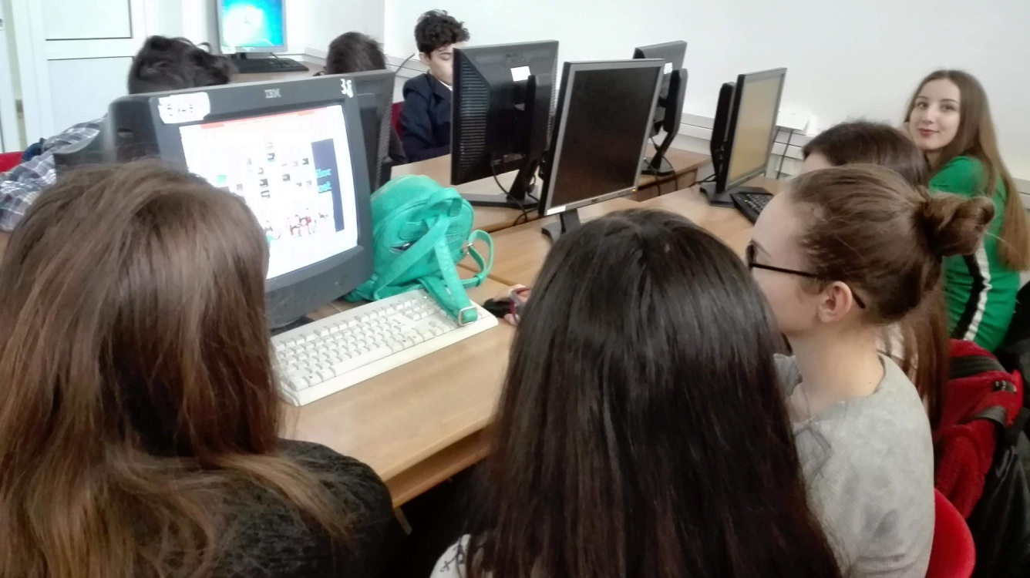
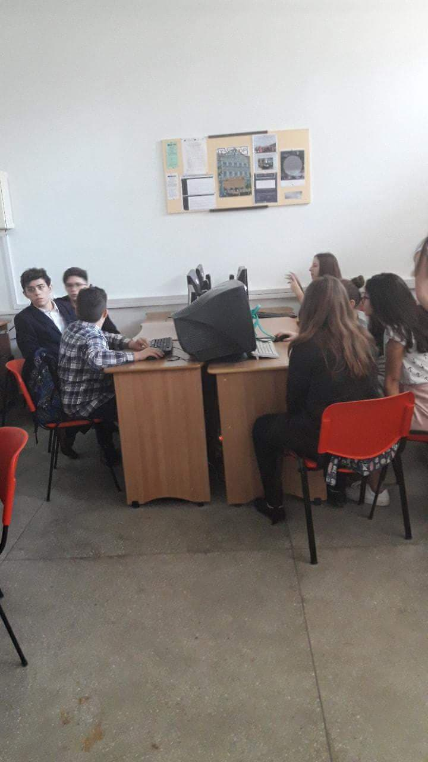
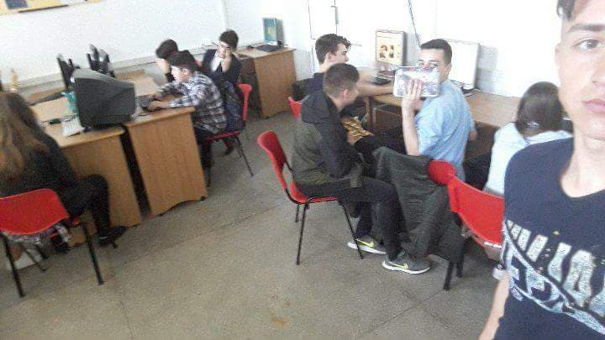
Group activities

