Slide 1
Sharing the world: disability and displacement
Erasmus+ Programme – Strategic Partnership
Project Nr:
2017-1-FR-01-KA219-037504_5
KA2 - Cooperation for Innovation and the Exchange of Good Practices
KA219 - Strategic Partnerships for Schools Only
Project realised by:
Boca Miriana-Andreea
Andreea Tomescu

Slide 2
Date: 29.03.2018
Class: 9 A
School object: TIC
Subject: Knowing and respecting the rights of the child, the right to education
Type of lesson: communication / acquisition of new knowledge
Reserved Time: 50 minutes
Teacher: MIHAIELA TUNEA, ELENA ABRAHAMFI

Slide 3
The right to education is equally recognized for minors who have been or have been granted a form of protection in Romania, foreign minors and stateless children whose residence on the Romanian territory is officially recognized under the law. In Romania, education is a national priority.

Slide 4
RIGHTS
you have the right to quality education that gives you equal chances of succeeding in life and that contributes to the development of your personality;
the education you receive must develop physical, mental, talent, and personality abilities;
you have the right, with your parents or other growing adults, to choose your school and class profile;
the education you receive must be in the spirit of respect for your parents, your language, your identity and your cultural values, the national values ​​of the country where you live, and the different cultures and civilizations;

Slide 6
QUOTES
The roots of education are bitter, but the fruit is sweet. -Aristotle
The function of education is to teach one to think intensively and to think critically. Intelligence plus character - that is the goal of true education. -Martin Luther King, Jr.
Education is the kindling of a flame, not the filling of a vessel. -Socrates

Slide 7
Education is what remains after one has forgotten what one has learned in school. - Albert Einstein

Slide 9
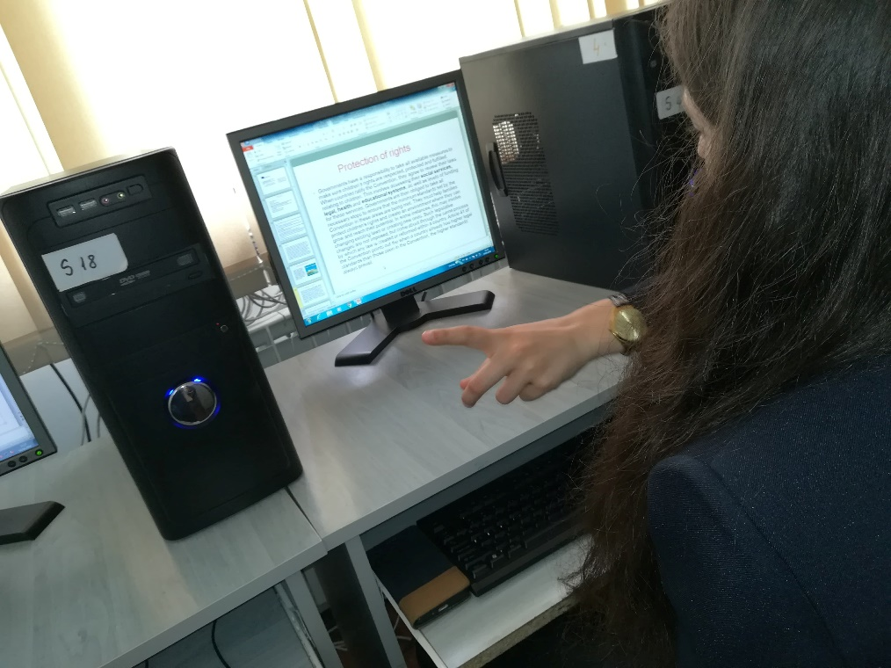
Group activities

Slide 10
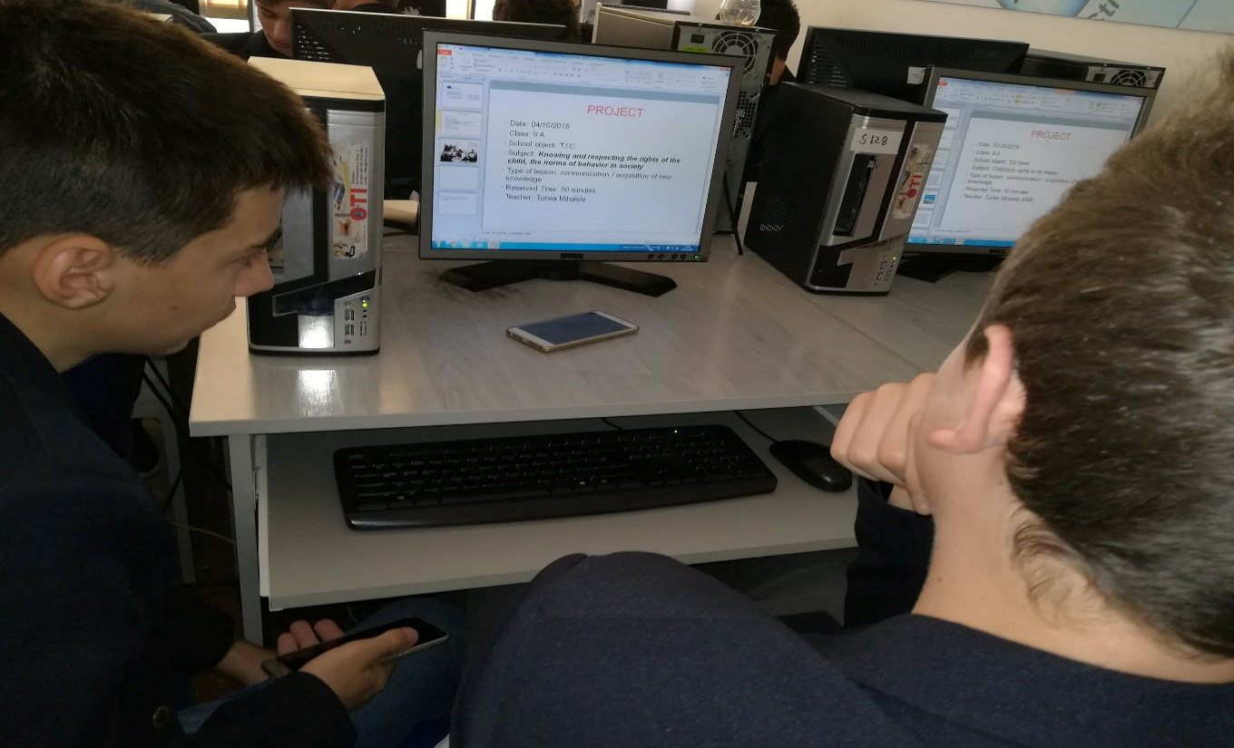

Slide 11
This material is the author's opinion and does not represent the official opinion of the European Commission.

