Slide 1
Erasmus+ Programme – Strategic Partnership Project Nr: 2017-1-FR-01-KA219-037504_5
KA2 - Cooperation for Innovation and the Exchange of Good Practices
KA219 - Strategic Partnerships for Schools Only
Sharing the world: disability and displacement
EDUCATIONAL RIGHT
FEDIUC ALEXANDRU
ADOCHITEI CATALIN COSMIN
TOMA EUSEBIU MIHAI

Slide 2
Date: 03/29/2018
Class: 11 F
School object: TIC
Subject: Knowing and respecting the rights of the child, the norms of behavior in society
Type of lesson: communication / acquisition of new knowledge
Reserved Time: 50 minutes
Teachers:
Mihaiela Tunea
Teodora Ursulica,
Ghinet Lavinia

Slide 3
Everybody has the right to education
The right to education also includes a responsibility to provide basic education for individuals who have not completed primary education. In addition to these access to education provisions, the right to education encompasses the obligation to avoid discrimination at all levels of the educational system, to set minimum standards and to improve the quality of education.

Slide 4
Education as a human right means:
The right to education is legally guaranteed for all without any discrimination
states have the obligation to protect, respect, and fulfil the right to education
there are ways to hold states accountable for violations or deprivations of the right to education

Slide 5
MOST AFFECTED REGIONS
As a result of poverty and marginalization, more than 72 million children around the world remain unschooled.
Sub-Saharan Africa is the most affected area with over 32 million children of primary school age remaining uneducated. Central and Eastern Asia, as well as the Pacific, are also severely affected by this problem with more than 27 million uneducated children.
Additionally, these regions must also solve continuing problems of educational poverty (a child in education for less than 4 years) and extreme educational poverty (a child in education for less than 2 years).

Slide 6
MOST AFFECTED REGIONS
Essentially this concerns Sub-Saharan Africa where more than half of children receive an education for less than 4 years. In certain countries, such as Somalia and Burkina Faso, more than 50% of children receive an education for a period less than 2 years.
The lack of schooling and poor education have negative effects on the population and country. The children leave school without having acquired the basics, which greatly impedes the social and economic development of these countries.

Slide 7
Inequality between girls and boys: the education of girls in jeopardy
Today, it is girls who have the least access to education. They make up more than 54% of the non-schooled population in the world.
This problem occurs most frequently in the Arab States, in central Asia and in Southern and Western Asia and is principally explained by the cultural and traditional privileged treatment given to males. Girls are destined to work in the family home, whereas boys are entitled to receive an education.

Slide 8
Inequality between girls and boys:
the education of girls in jeopardy
In sub-Saharan Africa, over 12 million girls are at risk of never receiving an education. In Yemen, it is more than 80% of girls who will never have the opportunity to go to school. Even more alarming, certain countries such as Afghanistan or Somalia make no effort to reduce the gap between girls and boys with regard to education.
Although many developing countries may congratulate themselves on dramatically reducing inequality between girls and boys in education, a lot of effort is still needed in order to achieve a universal primary education.

Slide 9
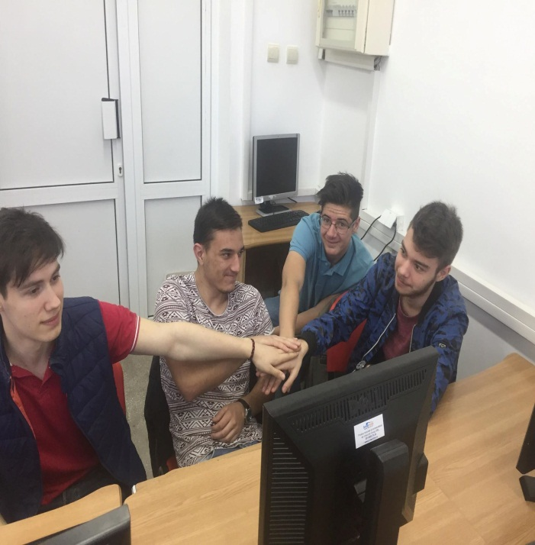
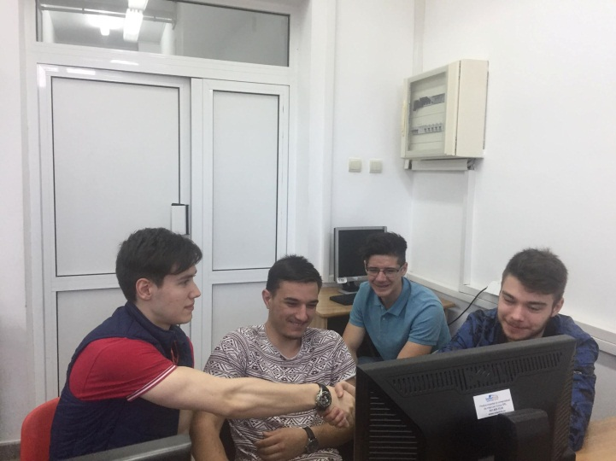
Group activities

Slide 10
This material is the author's opinion and does not represent the official opinion of the European Commission.

