Slide 1
Children’s Rights: The Right of Happiness
Erasmus+ Programme – Strategic Partnership
Project Nr:
2017-1-FR-01-KA219-037504_5
KA2 - Cooperation for Innovation and the Exchange of Good Practices
KA219 - Strategic Partnerships for Schools Only
Project realized by:
Alexa Constantin-Cosmin and Ariciuc Robert-Gabriel

Slide 2
Date: 19.04.2018
Class: 9 A
School object: TIC
Subject: The right of children to be happy
Type of lesson: communication / acquisition of new knowledge
Teacher: MIHAIELA TUNEA, ABRAHAMFI ELENA

Slide 3
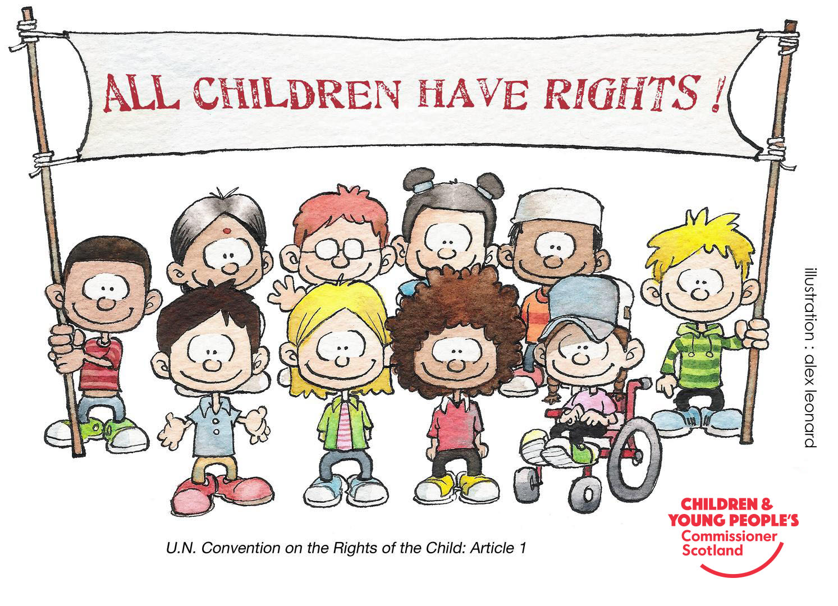

Slide 4
Happiness
In psychology, happiness is a mental or emotional state of well-being which can be defined by, among others, positive or pleasant emotions ranging from contentment to intense joy. Happy mental states may reflect judgements by a person about their overall well-being
“Don't cry because it's over, smile because it happened.” ― Dr. Seuss
“Happiness is when what you think, what you say, and what you do are in harmony.” ― Mahatma Gandhi

Slide 5
Why does children need do be happy?
The child's need to be happy varies according to ages. Moreover, happiness is not a temporary state of the moment, happiness is a complex concept. We have been equipped for it since birth, it is only up to us to acquire it. Happiness! Never let it down - "I will be happy if ...", "I will be happy only when ...“, “only you can make me happy“. We should never consider it someone else's responsibility and try to achieve it by ourselves.

Slide 6
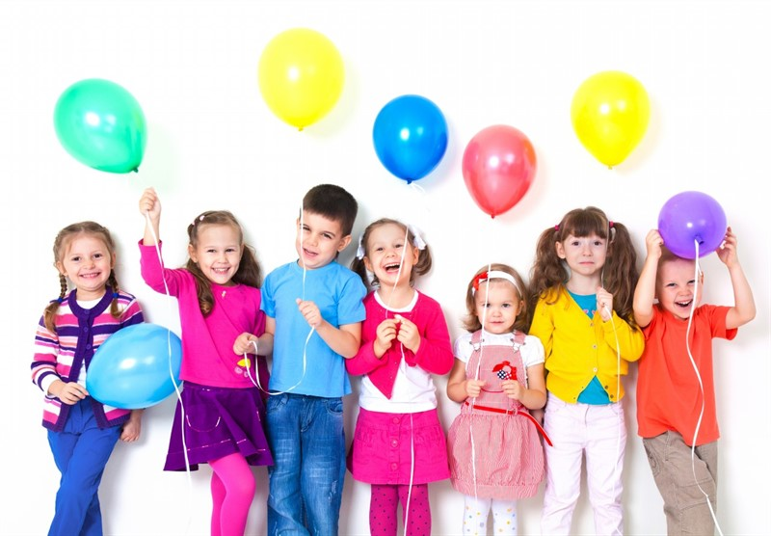
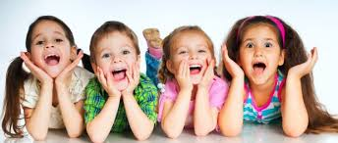
Happy children

Slide 7
10 Steps to Raise Happy Children
Step 1: Get Happy Yourself
Step 2: Teach Them To Build Relationships
Step 3: Expect Effort, Not Perfection
Step 4: Teach Optimism
Step 5: Teach Emotional Intelligence
Step 6: Form Happiness Habits
Step 7: Teach Self-Discipline
Step 8: More Playtime
Step 9: Rig Their Environment For Happiness
Step 10: Eat Dinner Together

Slide 9
10 Activities to make Children happy
1. See animals up close
2. Listen to music and dance
3. Explore new places
4. Listen to stories
5. Running outdoors
6. Dress up and see people in disguise
7. Go to the beach
8. Playing in the water
9. Eat sweets!
10. To get dirty

Slide 10
Why video games can make Children happy
Video games, whether violent or not, are a lightning rod for speculation and fear regarding their impact on children. Yet, we do not have to go far back in time when almost identical expressions of concern were made regarding comic books, novels and various genres of music - from rock to punk. While it would be foolish to suggest that every instance of a particular type of media is appropriate to all age groups (clearly Grand Theft Auto and A Clockwork Orange were not made to be consumed by children), it is essential that we take a balanced and considered approach.

Slide 11
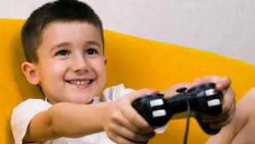
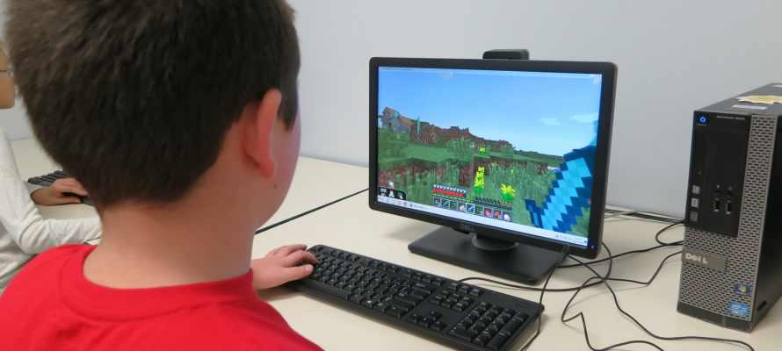
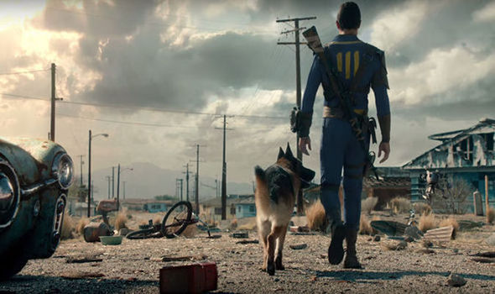

Slide 12
This material is the author's opinion and does not represent the official opinion of the European Commission.

