Slide 1
The right to protection against abuse
Erasmus+ Programme – Strategic Partnership
Project Nr:
2017-1-FR-01-KA219-037504_5
KA2 - Cooperation for Innovation and the Exchange of Good Practices
KA219 - Strategic Partnerships for Schools Only
Sharing the world: disability and displacement
Pompaş Mihnea-Teodor
Pomîrleanu Delian

Slide 2
PROJECT
Date: 29/03/2018
Class: 11 F
School object: T.I.C.
Subject: Knowing and respecting the rights of the child, the norms of behavior in society
Type of lesson: communication / acquisition of new knowledge
Reserved Time: 50 minutes
Teachers: Mihaiela Tunea
Teodora Ursulica,
Ghinet Lavinia

Slide 3
Children have the right to protection from abuse.
According to the UNICEF Convention on the Rights of the Child, Article 19:
1.States Parties shall take all appropriate legislative, administrative, social and educational measures to protect the child from all forms of physical or mental violence, injury or abuse, neglect or negligent treatment, maltreatment or exploitation, including sexual abuse, while in the care of parent(s), legal guardian(s) or any other person who has the care of the child.
2. Such protective measures should, as appropriate, include effective procedures for the establishment of social programmes to provide necessary support for the child and for those who have the care of the child, as well as for other forms of prevention and for identification, reporting, referral, investigation, treatment and follow-up of instances of child maltreatment described heretofore, and, as appropriate, for judicial involvement.

Slide 4
Child protection systems are a set of usually government-run services designed to protect children and young people who are underage and to encourage family stability. UNICEF defines a ”child protection system” as:
- the set of laws, policies, regulations and services needed across all social sectors – especially social welfare, education, health, security and justice – to support prevention and response to protection-related risks. These systems are part of social protection, and extend beyond it. At the level of prevention, their aim includes supporting and strengthening families to reduce social exclusion, and to lower the risk of separation, violence and exploitation. Responsibilities are often spread across government agencies, with services delivered by local authorities, non-State providers, and community groups, making coordination between sectors and levels, including routine referral systems, a necessary component of effective child protection systems.
( United Nations Economic and Social Council (2008), UNICEF Child Protection Strategy, E/ICEF/2008/5/Rev.1, par. 12-13)

Slide 5
International treaties
The International Labour Organization (ILO) is a United Nations agency dealing with labour issues, created in 1919. It takes care also of child labour issues, in particular with conventions 138 and 182.
On 20 November 1959 the United Nations General Assembly adopted a Declaration of the Rights of the Child during the Convention on the Rights of the Child.
The United Nations Children's Fund (UNICEF) is a United Nations Programme headquartered in New York City, that provides long-term humanitarian and developmental assistance to children and mothers in developing countries.
In 2000, an agreement was reached among UNO countries about the military use of children.
The effectiveness of these programs is contested and seems limited to some.

Slide 6
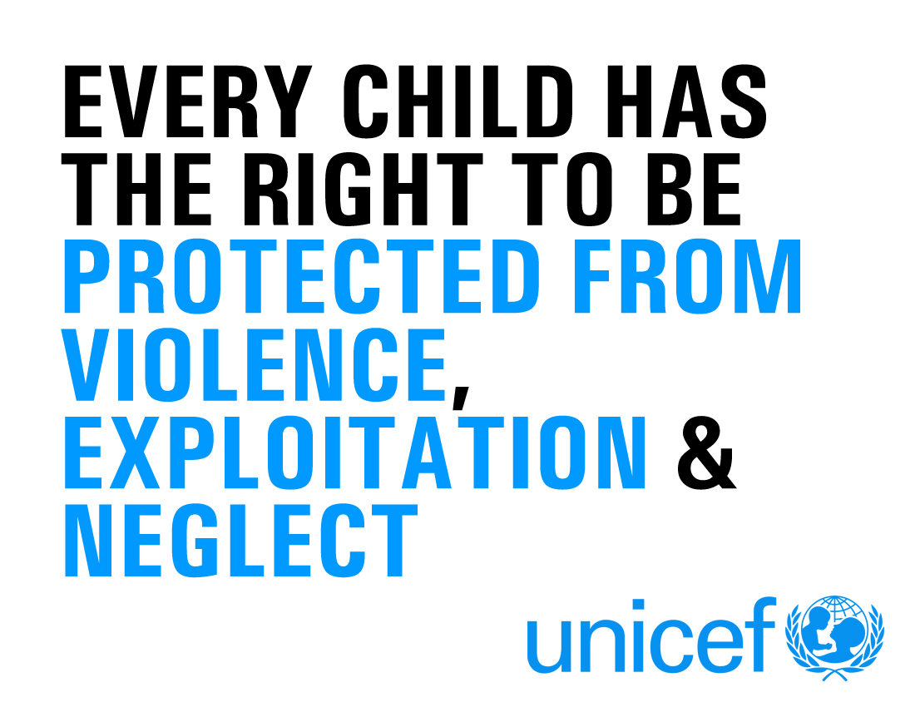

Slide 7
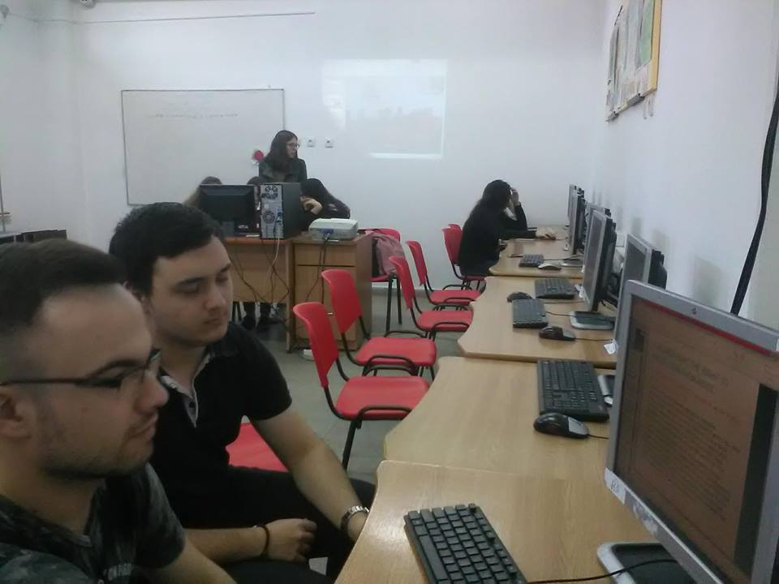
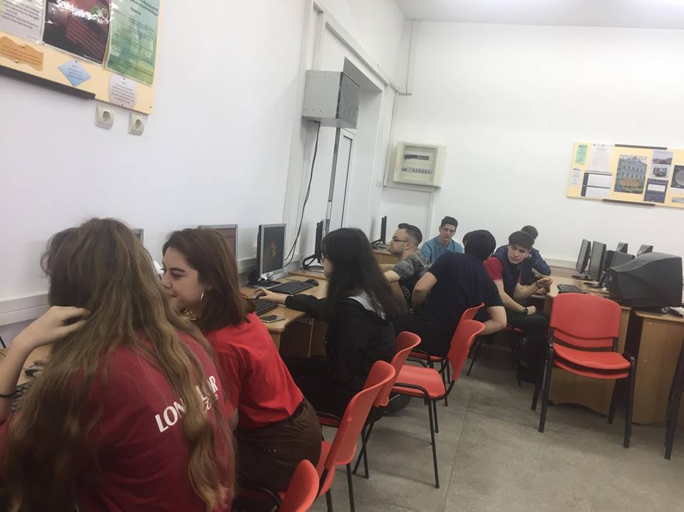
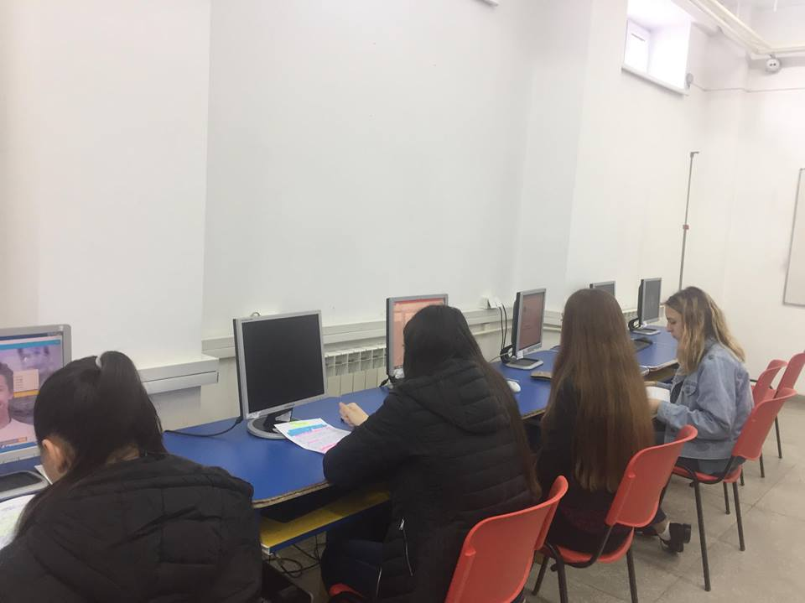
GRUP ACTIVITIES

Slide 8
DISCLAIMER
This material is the author's opinion and does not represent the official opinion of the European Commission.

