Slide 1
KA2 - Cooperation for Innovation and the Exchange of Good Practices
KA219 - Strategic Partnerships for Schools Only
Sharing the world: disability and displacement
Erasmus+ Programme, Strategic Partnership
Project Nr: 2017-1-FR-01-KA219-037504_5
Project realised by:
Aferaritei Amalia
Aferaritei Denisia
Dutcovschi Denisa
Lupascu Delia

Slide 2
PROJECT
Date: 04/13/2018
Class: 9 F
School object: TIC
Subject: Knowing and respecting the rights of the child, the children`s rights to education
Type of lesson: communication / acquisition of new knowledge
Reserved Time: 50 minutes
Teacher: Tunea Mihaiela
Elena-Magda Soptica

Slide 3
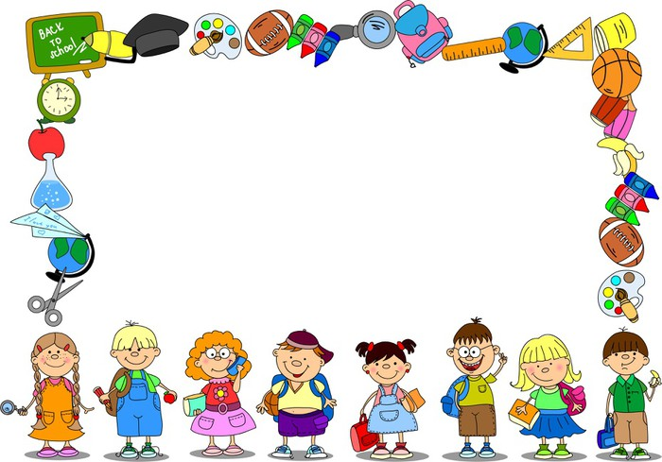
Children’s rights education (or children’s human rights education) is the teaching and practice of children’s rights in schools and educational institutions, as informed by and consistent with the United Nations Convention on the Rights of the Child. When fully implemented, a children's rights education program consists of both a curriculum to teach children their human rights, and framework to operate the school in a manner that respects children's rights. Articles 29 and 42 of the Convention on the Rights of the Child require children to be educated about their rights.

Slide 4
Meaning of children’s human rights education
Children’s human rights education refers to education and educational practices in schools and educational institutions that are consistent with the United Nations Convention on the Rights of the Child. It is a form of education that takes seriously the view that children are bearers of human rights, that children are citizens in their own right, that schools and educational institutions are learning communities where children learn (or fail to learn) the values and practices of human rights and citizenship, and that educating children about their own basic human rights is a legal obligation of the United Nations Convention on the Rights of the Child.

Slide 5
Value of children’s human rights education
Children’s rights education in schools has value because it fulfills the obligations of countries to respect the rights of the child and implement the provisions of the Convention. But beyond the fulfillment of a legal obligation, children’s rights education has value for children. Felisa Tibbitts has suggested that child rights education can be expected to affect learners in three ways. First is in the providing of basic information and knowledge on the nature of rights and the specific rights that children are to enjoy. Children can be expected to have a more accurate and deeper understanding of rights. Second is in attitudes, values, and behaviors consistent with the understanding of rights. Children can be expected to have greater respect for the rights of others as shown in their attitudes and behaviors.

Slide 6
Equal opportunities are the concept that all human beings are free to develop their personal capacities and to choose without strict limitations imposed by strict roles. Equal opportunities are based on ensuring full participation of every person in economic and social life, regardless of ethnic origin, sex, religion, age, disability, etc. School is the cradle of childhood in which all hopes can become reality if those taking part in learning activities, poets and pupils are aware of the diversity and complexity of human nature and harness every talent or creative side given by God.

Slide 7
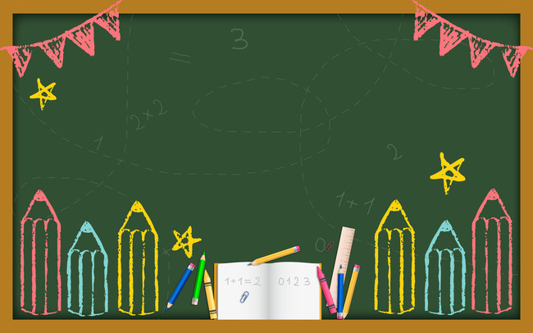
Equal opportunities mean, in fact, the provision of multiple choices for different capacities and skills, "education for all and for everyone", an open education for all people, regardless of age and socio-economic conditions, but also education for everyone, depending on its specific needs - avoiding homogenization and encouraging diversity - that create the prerequisites for equal opportunities for access to social life. This option was supported by equal opportunities policies that had the objective of combating exacerbated exclusion and selection, basic skills training for all individuals, second chance education for those who left the education system, integration of formal education with non-formal education and informal education so as to extend learning situations.

Slide 8
In the category of disadvantaged children we can include those from single parents or orphans of both parents, children whose parents are unemployed, have serious health problems or immoral behavior, children who live in isolated or remote areas and whose schooling depends on the existence of a means of transport and Roma children who integrate with weight into the classroom of the pupils. The advent of diversity is a response to the pluralism of all sorts of things we face. Valuing diversity allows for tolerance; recognizes, appreciates and facilitates processes involved in the exploration and discovery of the new, leads to the strengthening of the relations within the community and increases the possibilities of the young people to achieve themselves in a more complex pluralistic society. Educational institutions must take appropriate measures to eliminate any form of discrimination within them.

Slide 9
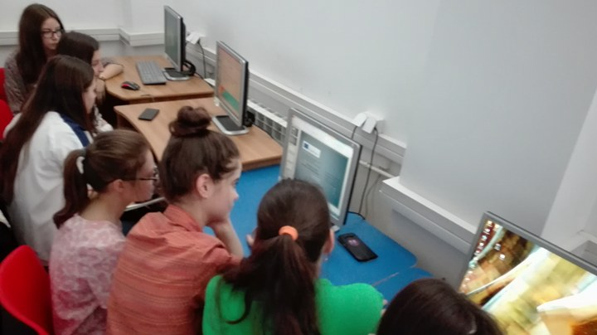
GROUP ACTIVITIES

